Slide 3
JONAH CHAPTER 3
Then the word of the Lord came to Jonah a second time: ² “Go to the great city of Nineveh and proclaim to it the message I give you.”
³ Jonah obeyed the word of the Lord and went to Nineveh. Now Nineveh was a very large city; it took three days to go through it. ⁴ Jonah began by going a day’s journey into the city, proclaiming, “Forty more days and Nineveh will be overthrown.”

Slide 4
⁵ The Ninevites believed God. A fast was proclaimed, and all of them, from the greatest to the least, put on sackcloth.
⁶ When Jonah’s warning reached the king of Nineveh, he rose from his throne, took off his royal robes, covered himself with sackcloth and sat down in the dust.
⁷ This is the proclamation he issued in Nineveh:

Slide 5
“By the decree of the king and his nobles:
Do not let people or animals, herds or flocks, taste anything; do not let them eat or drink. ⁸ But let people and animals be covered with sackcloth. Let everyone call urgently on God. Let them give up their evil ways and their violence. ⁹ Who knows? God may yet relent and with compassion turn from his fierce anger so that we will not perish.”

Slide 6
¹⁰ When God saw what they did and how they turned from their evil ways, he relented and did not bring on them the destruction he had threatened.

Slide 7
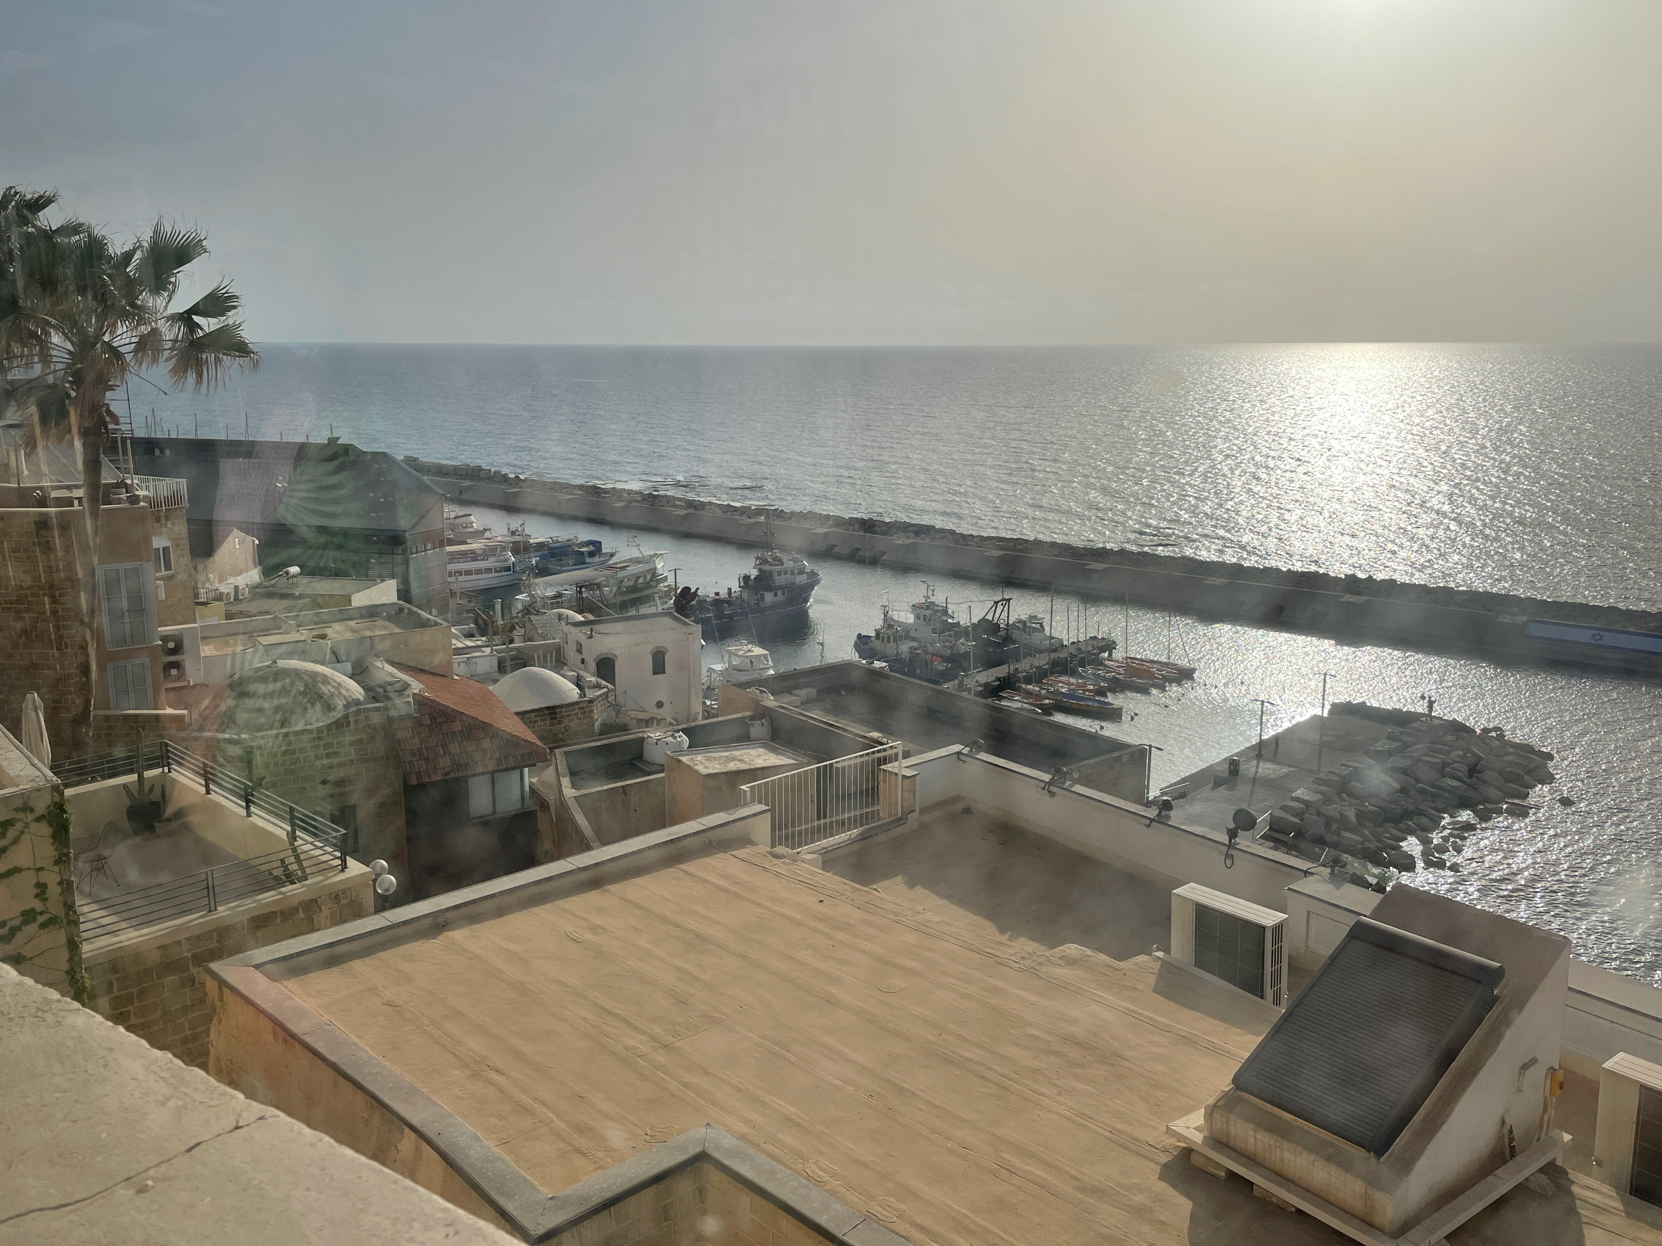
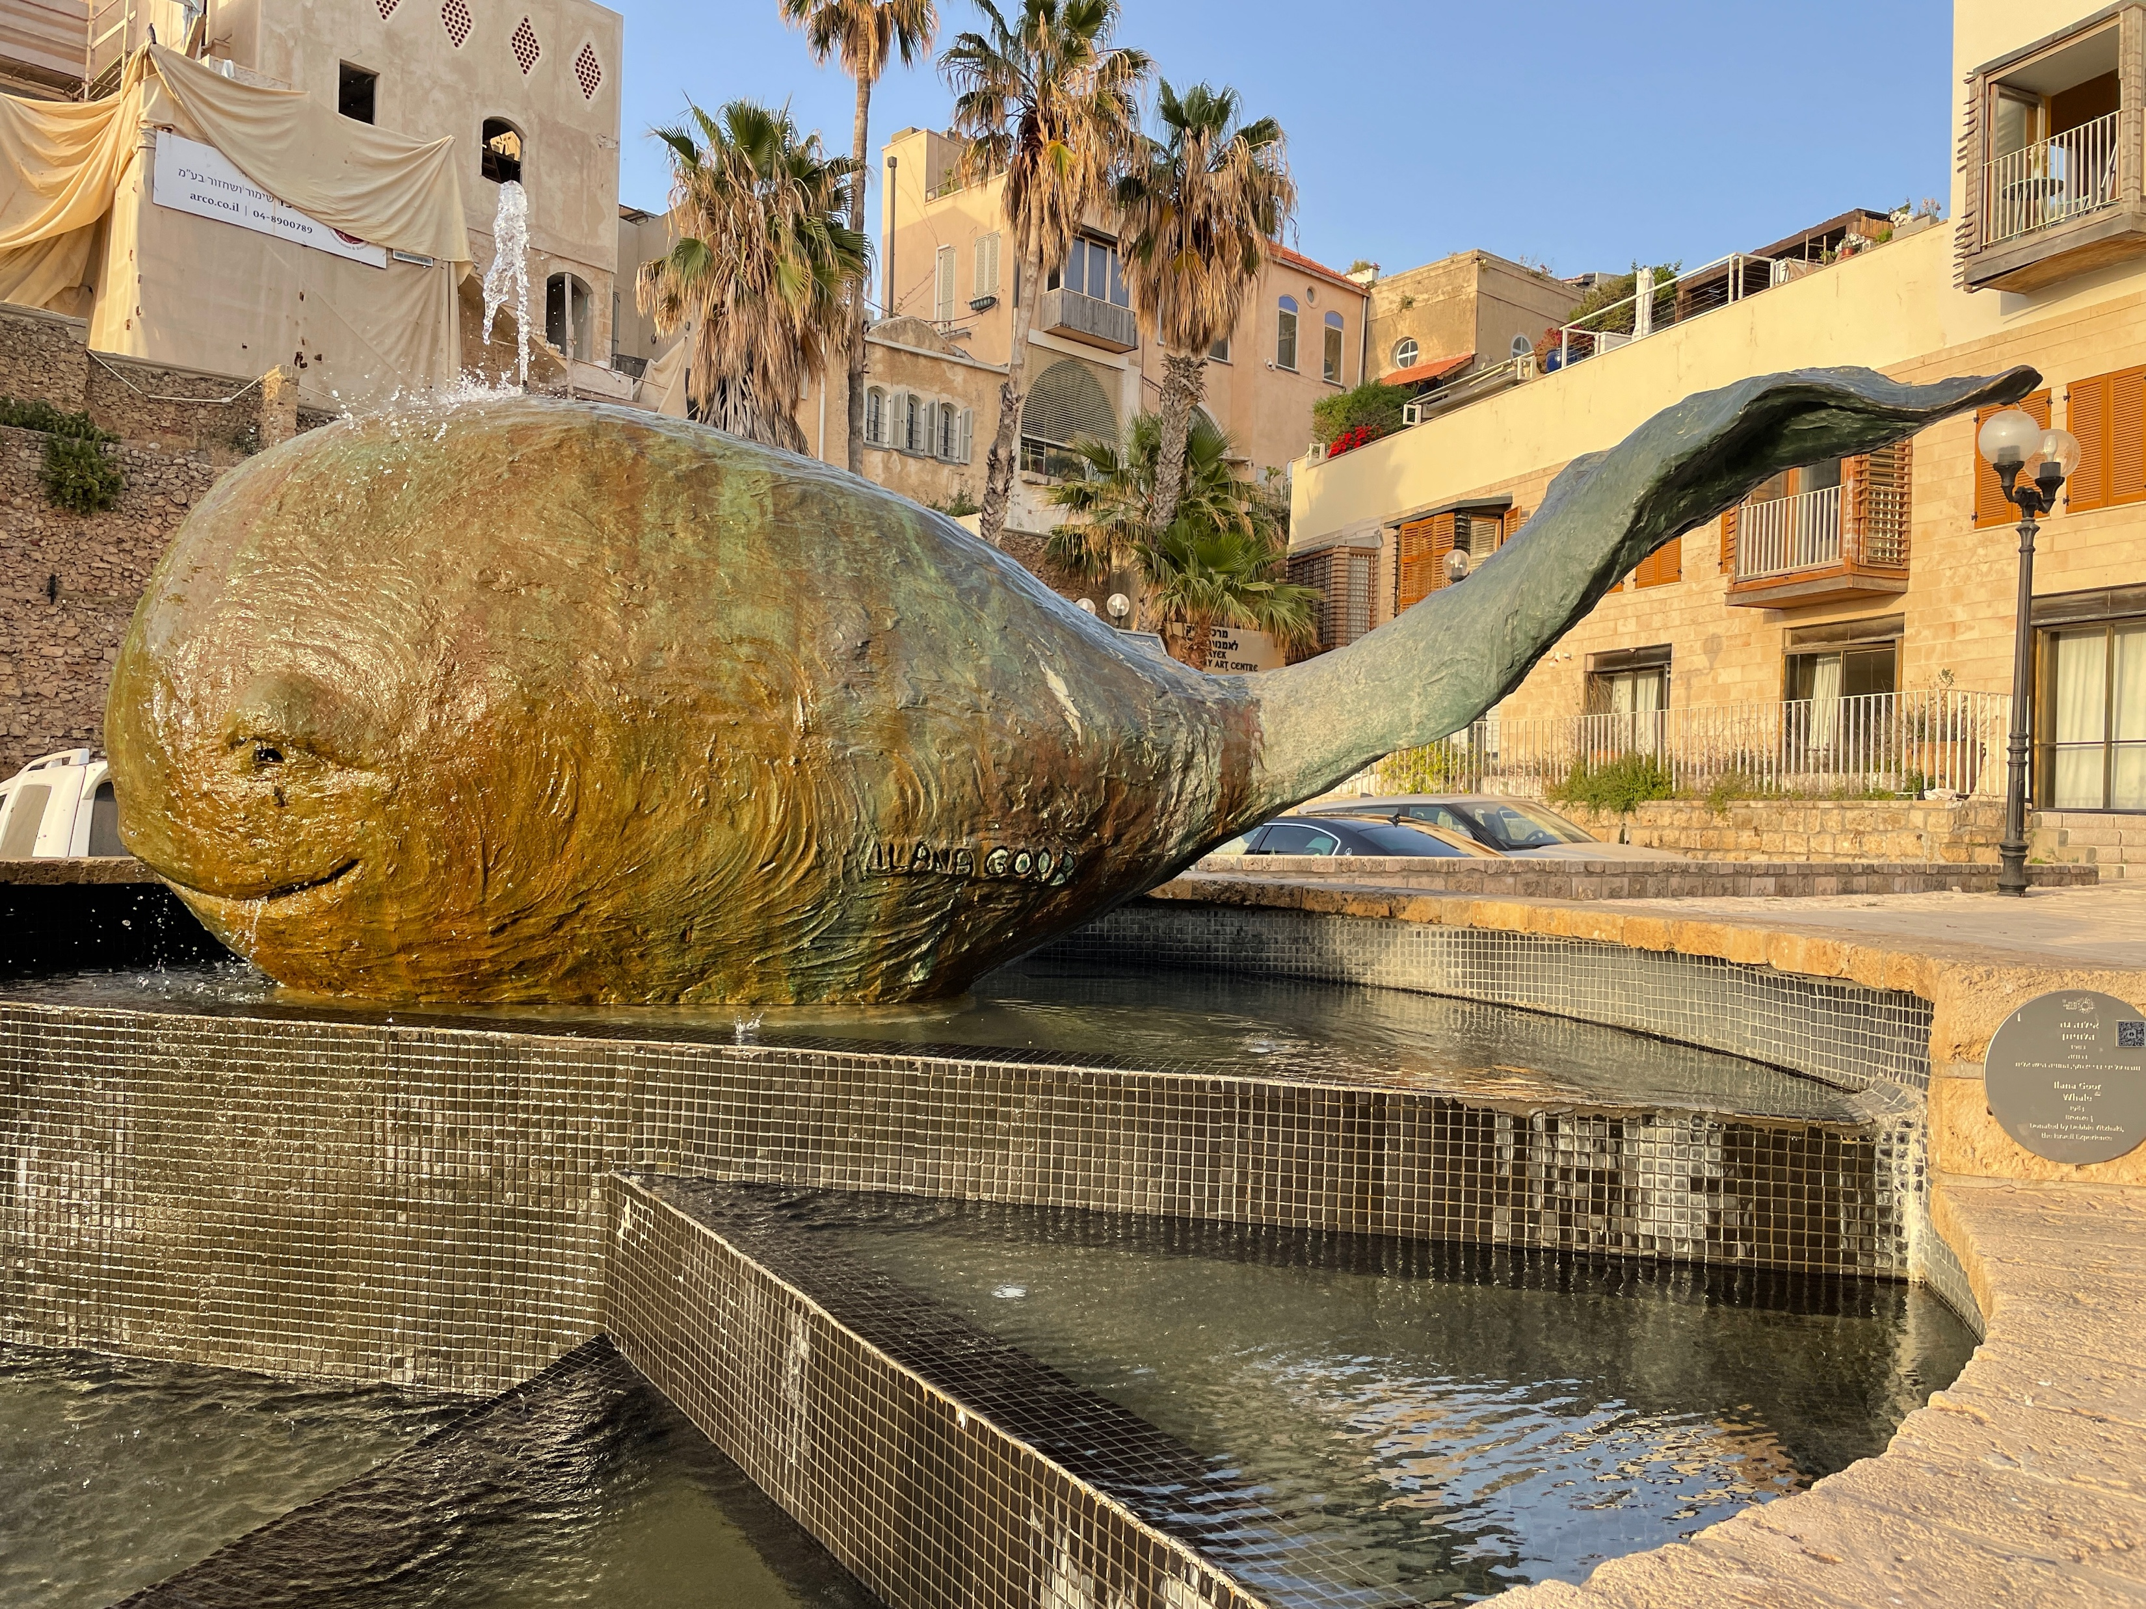
CONTEXT OF CHAPTER 3
CHAPTER 1 JONAH fled God’s gracious purpose for his life and the people of Nineveh
MODERN JOPPA – CONTRAST JONAH 1:1-3 & ACTS 10:1-48

Slide 8
CONTEXT OF CHAPTER 3
CHAPTER 1 JONAH fled God’s gracious purpose for his life and the people of Nineveh
God got his attention and graciously saved him and his travelling companions (storm + fish)
CHAPTER 2 JONAH returns to the Lord and the land
CHAPTER 3 JONAH becomes an instrument of God’s grace
CHAPTER 4 An unhappy JONAH learns about the depths of God’s grace.

Slide 9
CHARACTERS: NINEVEH
Capital City of the Assyrian Empire
Going about business unaware of impending doom
PICTURES: The human condition living without God
PICTURES: The societal transformation possible through repentance

Slide 10
CHARACTERS: GOD
Desiring Nineveh’s repentance
Disciplining Jonah
Using Jonah
Forgiving Nineveh
PICTURES: God’s character as JUDGE & SAVIOUR

Slide 11
CHARACTERS: STORM & FISH
Instruments of God’s discipline & restoration
PICTURES: God’s use of circumstances and people to bring us back into line.
God’s loving discipline [HEBREWS 12:4-11]

Slide 12
CHARACTERS: JONAH
Disobedience, Discipline, Restoration, Fulfilment
PICTURES: The need for someone to proclaim God’s message
The reluctance we can have to do God’s will.
That when we are in the right place with God and his purpose he can use us mightily.

Slide 13
CHARACTERS: SAILORS
Afraid, Desperately Prayerful, Searching, Compassionate,
Fearfully Prayerful
PICTURES: Deeply spiritual people who do not know the one true God, yet are honourable and sometimes put true believers to shame.

Slide 14
PURPOSE OF JONAH
To reveal the gracious nature of the LORD
To address Israel’s lack of concern for the plight of non-Hebrews
narrative polemic: JOB
LUKE 15
ACTS 2:42-47

Slide 15
CHAPTER 3: GOD IS THE GOD OF THE SECOND CHANCE
JONAH - (1:1-3 & 3:1-3)
The word of the Lord came to Jonah son of Amittai: “Go to the great city of Nineveh and preach against it, because its wickedness has come up before me.” But Jonah ran away from the Lord and headed for Tarshish. | Then the word of the Lord came to Jonah a second time: “Go to the great city of Nineveh and proclaim to it the message I give you.” Jonah obeyed the word of the Lord and went to Nineveh.

Slide 16
CHAPTER 3: GOD IS THE GOD OF THE SECOND CHANCE
JONAH - (1:1-3 & 3:1-3)
JONAH’S second chance brought Nineveh grace (3:10)
When God saw what they did and how they turned from their evil ways, he relented and did not bring on them the destruction he had threatened.

Slide 17
CHAPTER 3: REPENTANCE TOWARDS GOD IS MET WITH GRACE
JONAH’S repentance restored his purpose and mission
NINEVEH’S repentance saved them from certain doom

Slide 18
CHAPTER 3: GOD USES PEOPLE AS MESSENGERS OF GRACE
NINEVEH’S PROBLEM: Under Judgement
Proclaimer (Jonah)
Receptivity & Repentance (Ninevites)
NINEVEH’S SALVATION: Under Grace

Slide 19
CHAPTER 3: GOD USES PEOPLE AS MESSENGERS OF GRACE
HUMANITY’S PROBLEM: Under Judgement
Proclaimers required to be prophetic witnesses Receptivity & Repentance required by people
HUMANITY’S SALVATION: Under Grace

Slide 20
BE WILLING RATHER THAN RELUCTANT MESSENGERS OF GRACE
Be ‘in the city’ = with people
In the context of those relationships take God’s opportunity to be a messenger: testimony, prayer, explanation
Our proclamation is likely to be less preachy than Jonah’s and more personal like Jesus and Paul.
Don’t stress about the results
Results are God’s business

Slide 21
EMBRACE THE GRACE YOU NEED NOW
JONAH GRACE
Grace for believers who walk away from God’s purpose for their life [1 JOHN 1:9]
NINEVEH GRACE
Grace for unbelievers who turn repentantly to God through faith in the Lord Jesus Christ [JOHN 1:11-13]

Slide 22
EMBRACE THE GRACE YOU NEED NOW
COMMUNION
Reflect on grace
Embrace grace

